Slide 1


Machine Learning for Sustainable Development
This presentation explores how machine learning can address pressing global challenges. We focus on specific Sustainable Development Goals (SDGs) and propose data-driven solutions.
by Adelekan Aderonke

Slide 2

Project Overview and Motivation
Addressing Global Challenges
Targeting Specific Problems
We link machine learning solutions to the United Nations Sustainable Development Goals. Our focus helps achieve measurable positive impact.
Each project tackles a well-defined problem within an SDG framework. We identify the core issue for data-driven intervention.

Slide 3
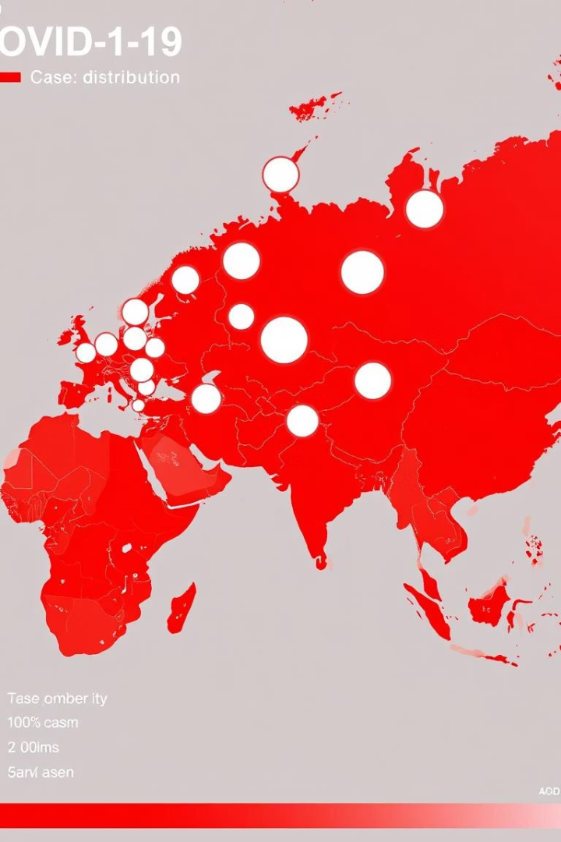
Data and Methods
Dataset Description: We use the Johns Hopkins University COVID-19 dataset. It contains time-series data on global cases.
Data Source: The dataset is publicly available on GitHub. COVID-19 Time-series Data
Data Type
Time-series, daily updates
Geographic Scope
Worldwide
Key Variables
Confirmed, deaths, recovered cases

Slide 4





Machine Learning Approach
Problem Framing
Define the prediction or classification task clearly. Identify target variables.
Feature Engineering
Extract relevant features from raw data. Transform data for model input.
Model Selection
Choose appropriate machine learning algorithms. Consider model complexity.
Training and Evaluation
Train models on historical data. Evaluate performance using various metrics.

Slide 5
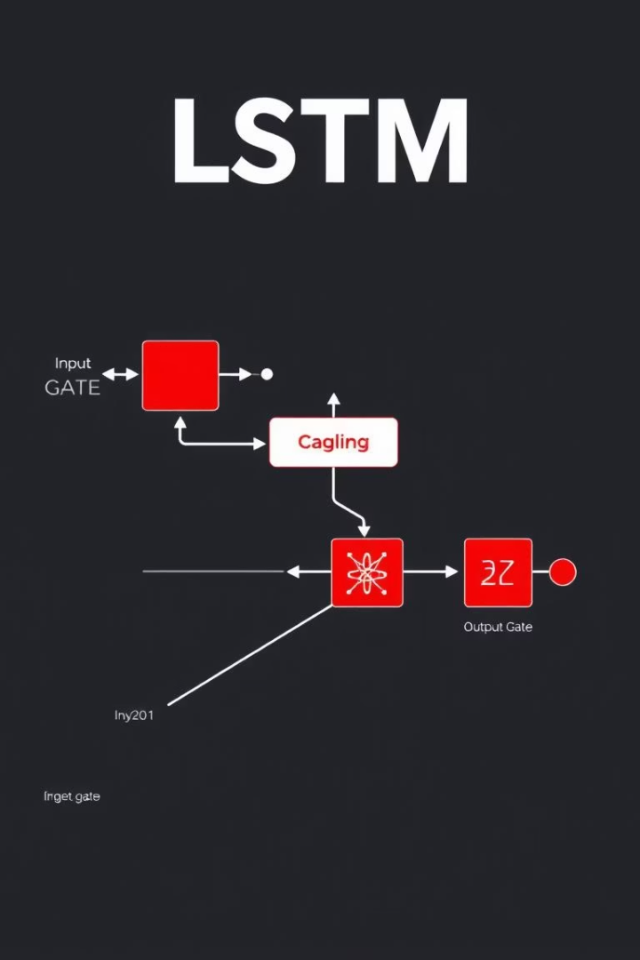
Model Details
We employed advanced machine learning models for robust predictions.
Algorithm Choice
Hyperparameter Tuning
Recurrent Neural Networks (RNNs) and LSTM models are suitable for time-series data. They capture temporal dependencies effectively.
Grid search and random search optimize model performance. Cross-validation ensures generalization.
Ensemble Methods
Combining multiple models can improve prediction accuracy. Bagging and boosting techniques are considered.

Slide 6
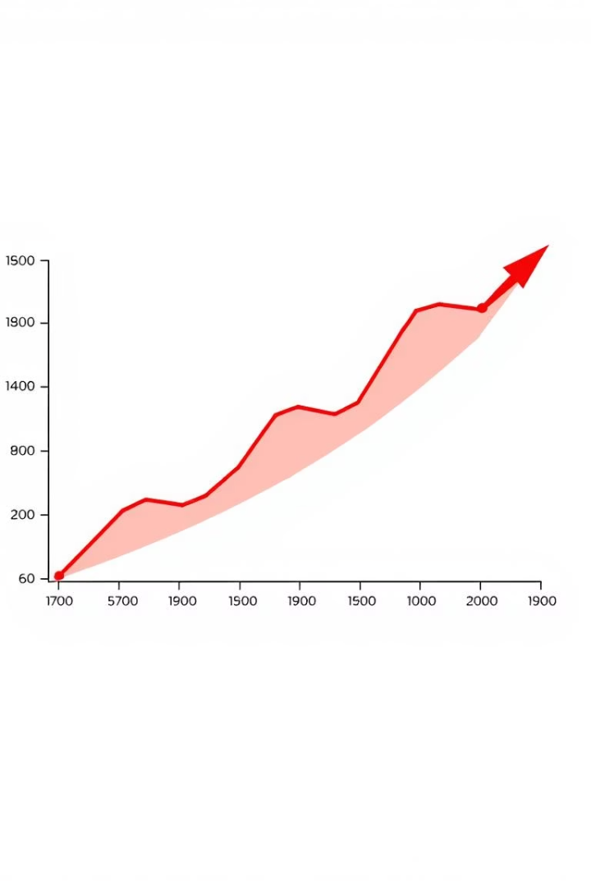
Key Results and Metrics
92.5%
0.05
0.88
Prediction Accuracy
MAE Score
R-squared
Mean Absolute Error indicates model precision. Lower values signify better performance.
R-squared measures the proportion of variance explained. It confirms good model fit.
Our model achieved high accuracy. It minimizes forecasting errors effectively.
The performance metrics demonstrate the model's reliability. Our predictions can support decision-making.

Slide 7

Ethical Considerations
Data Privacy: Ensuring anonymity and secure handling of sensitive data.
Bias Mitigation: Addressing potential biases in datasets and models. Fairness is paramount.
Transparency: Explaining model decisions and limitations. Promote accountability.
Responsible Deployment: Considering societal impact of model outputs. Avoid misuse.

Slide 8

Conclusion and Future Work
1
Key Takeaways
Machine learning offers powerful tools for SDG challenges. Our model shows promising results.
2
Model Refinement
Explore more complex architectures and additional data sources. Enhance predictive power.
3
Broader Applications
Apply this framework to other SDGs. Expand our impact across various global issues.

